Slide 1
NBA 23-24 Analysis
By: Refugio Zepeda, Henry Yost, and Dmitry Sorokin
Notes:
title slide: Title, names.
• (5 pts) Introduction slides: Showcase data/variables that are being
explored; give background.
• (5 pts) Methodology/EDA slides: Showcase methodology and EDA
(with diagrams/charts if needed).
• (5 pts) Analysis slides: Present results and analyses (with diagrams/charts
if needed).
• (5 pts) Conclusion slides: Present conclusions and provide summaries
of the analyses

Slide 2
Introduction: Data and Background
We chose the NBA dataset for our project
Four our specific data set it will consist of the 2023-24 season in which the Boston Celtics became the champions after winning the NBA finals 4-1 and had Nikola Jokic as the regular season mvp
Variables
Contains statistics on NBA players including, but not limited to, age, team, position, 3-point attempts, and personal fouls.
Overall Objective
We will look over multiple relationships between variables in order to come to a conclusion within the context of our analysis

Slide 3
Methodology
In order to look at the relationship between variables, we will use scatter plots, histograms, and box plots to visualize our data
To test and analyze our data numerically, we will go through a multitude of tests including:
Confidence intervals with a t test
Linear regression testing
Logistic regression testing
In order to complete our test, we will using the following libraries in R:
ggplot2
MASS
A benefit of our method is that it will allow for a full understanding of our data with EDA

Slide 4
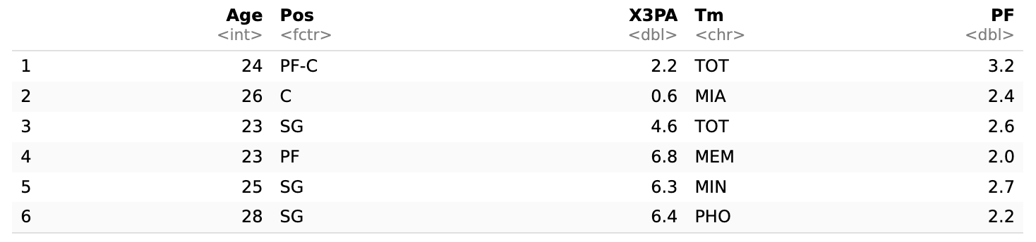
Exploratory Data Analysis (EDA)
Exploring the following data:
Age, Position (Pos), 3-point attempt (X3PA), Team (Tm), and personal fouls (PF).
Provide a strong analysis of player demographics and overall performance.

Slide 5
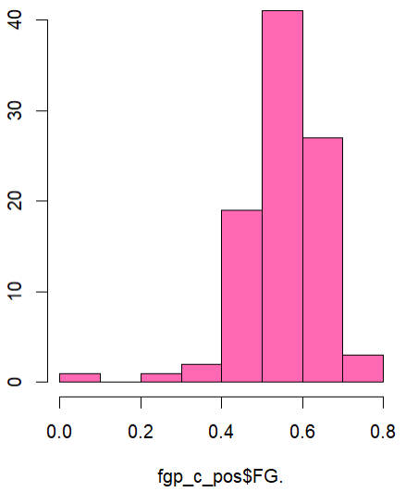
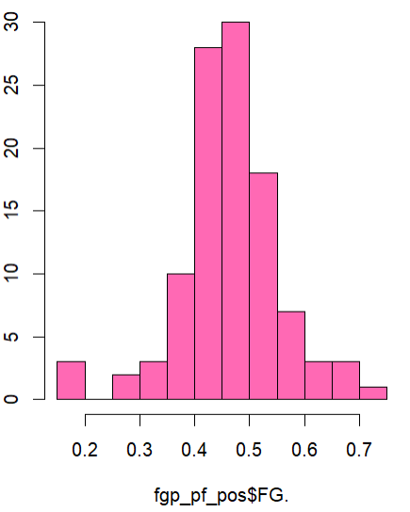
Exploratory Data Analysis (EDA)
FG% Distribution of a Center
Bell Shaped with a very strong frequency around 0.5 (50%)
Very few outliers
FG% Distribution of a Power Forward
Bell shaped with a strong frequency just between 0.4 and 0.5
Center has a higher range with the highest FG% being just before 80% while it was before 75%

Slide 6
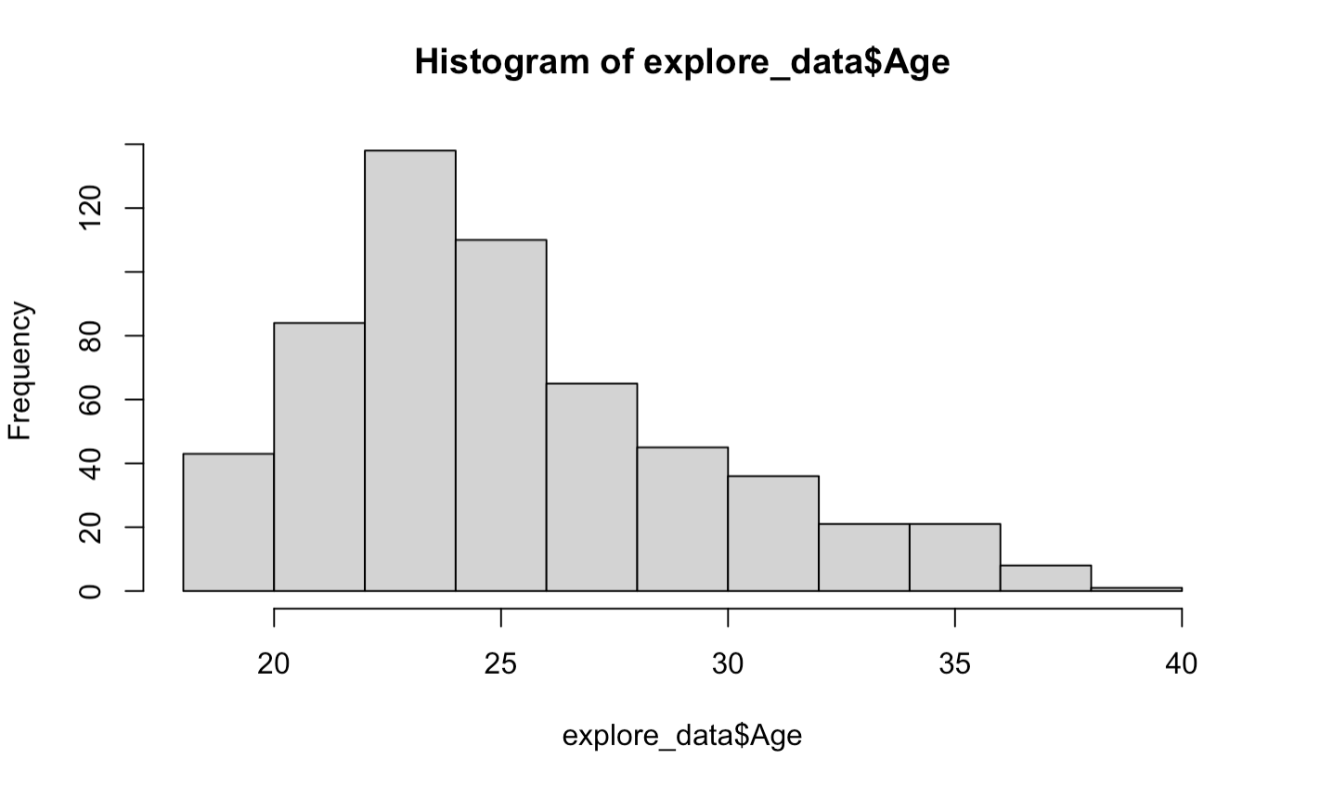
Exploratory Data Analysis (EDA)
Distribution of Age in the Dataset
Right-skewed
Expected in a physically demanding sport.
A common trend that is seen in most physically demanding sports, and professional sports in general.

Slide 7
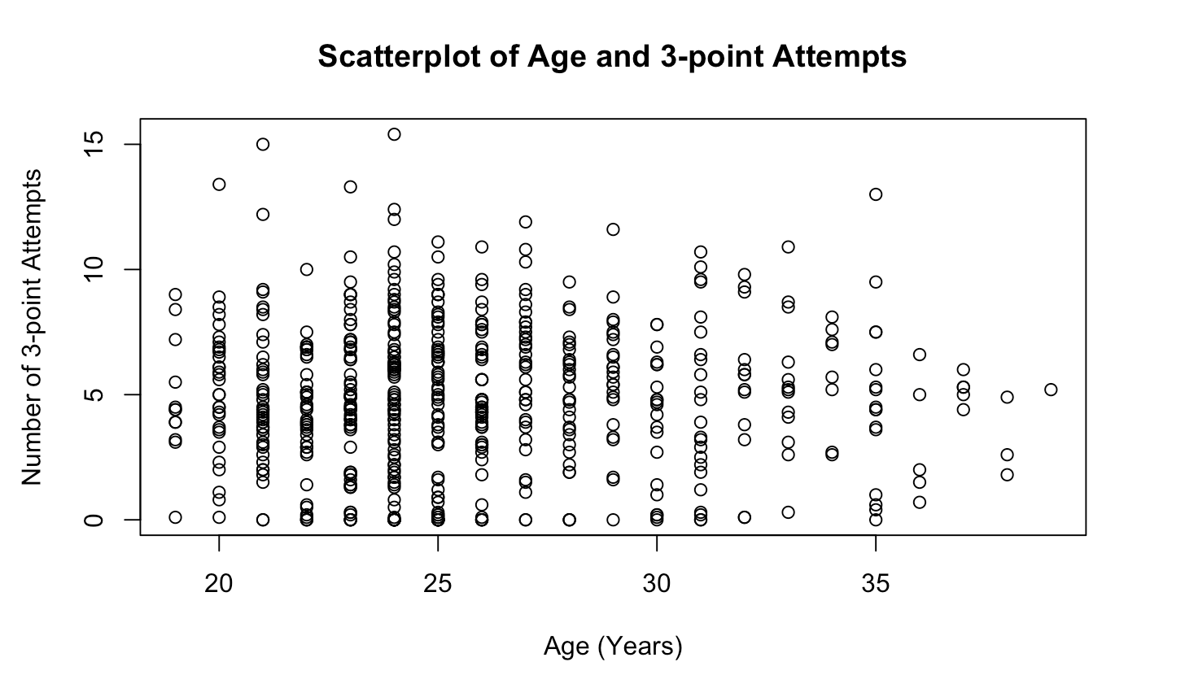
Exploratory Data Analysis (EDA)
Age versus 3-point Attempts
No clear relationship
Highest concentration of points amongst 23-25 age group.
Younger players are more likely to attempt 3-pointers
Declining density at around the age of 30.
Significant density decline by and past age 35.
Could indicate lack of players, and/or less likely to attempt 3-pointers.

Slide 8
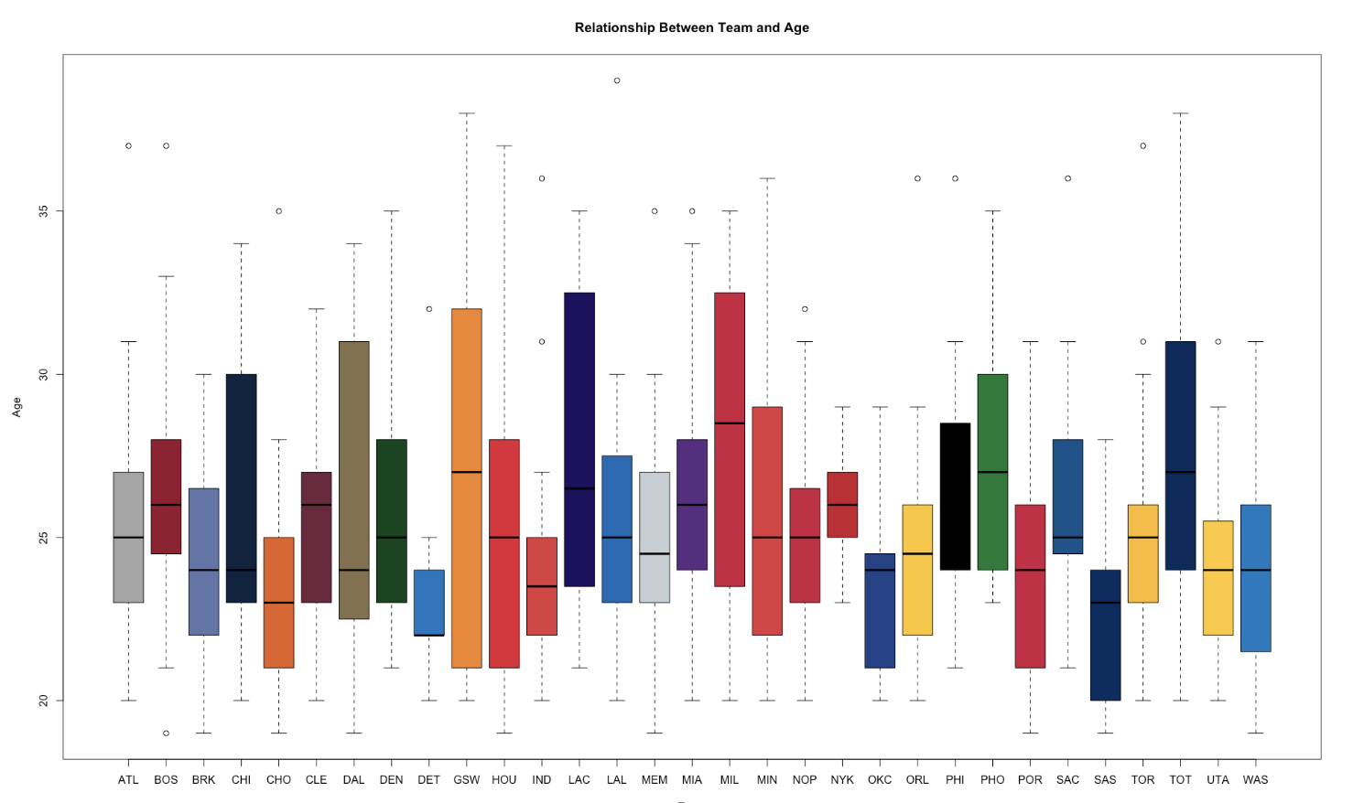
Exploratory Data Analysis (EDA)
Relationship between Team and Age
Expectation of narrower age ranges.
Younger players generally outperform older players.
Data shows a broader distribution.
New York Knicks have the smallest interquartile range (IQR)
Golden State Warriors (GSW) have the largest IQR.
GSW is significantly more spread out, compared to NYK.

Slide 9
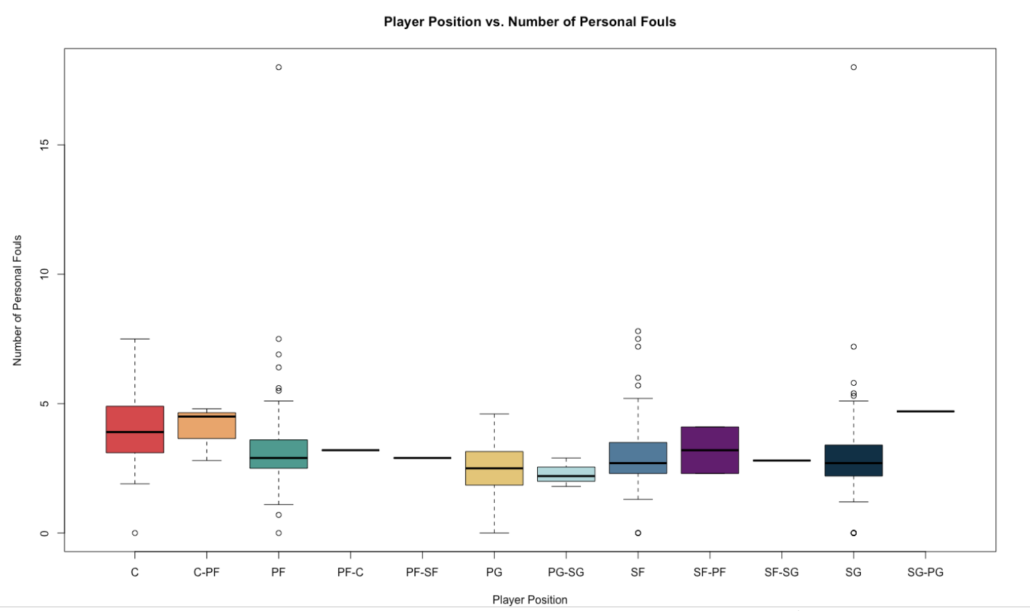
Exploratory Data Analysis (EDA)
Player Position vs. Personal Fouls
Point Forward and Shooting Forward have the most personal fouls.
Center position has a has a wider spread.
Median of 5 or < fouls.
Players playing multiple positions, have not received any personal fouls.

Slide 10


Analysis 1: Confidence Interval & T-test
Center FG% Confidence Interval
Sample mean of 55.43% FG
If we repeated a test to find the true mean of a center’s FG%, 95% of the true means would fall into our interval of 53.32% and 57.54%
Power Forward FG% Confidence Interval
Sample mean of 46.34%
If we repeated a test to find the true mean of a centers FG%, 95 of the true means would fall into our interval of 44.62% and 48.05%

Slide 11
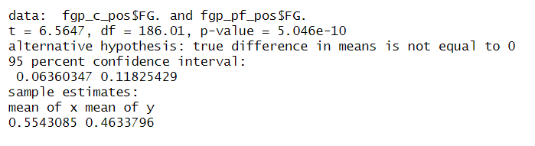
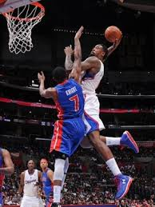
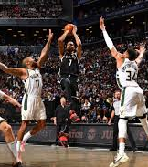
Analysis 1: Confidence Interval & T-test
Two Sample T Tests
H0 : mean_c = mean_pf
H1 : mean_c =- mean_pf
P-Value < 0.00
We reject the null hypothesis, since we have sufficient evidence to support there is a significant difference in means
95% confidence interval of mean differences
We are 95% confident that if we tested the difference in true means between a center’s fg% and a power forwards fg%, it would fall between 6.36% and 11.83%

Slide 12
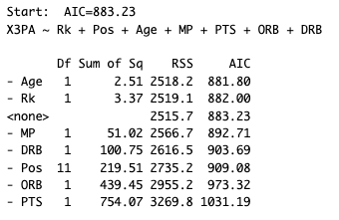
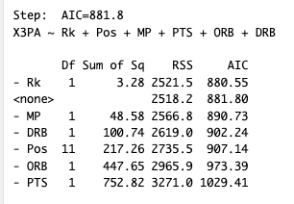
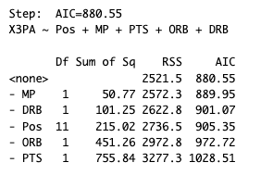
Analysis 2: Multi-Linear Regression
Goal: To predict the attempted number of 3-point shots that a player made
Explanatory Variables:
Original: rank (RK), position (Pos), age (Age), minutes played (MP), points (PTS), offensive rebounds (ORB), and defensive rebounds (DRB)
Optimized (Backward Elimination): position (Pos), minutes played (MP), points (PTS), offensive rebounds (ORB), and defensive rebounds (DRB)

Slide 13
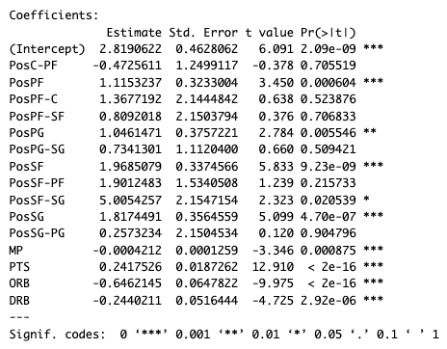

Multi-Linear Model Results
After our Backward Elimination, we got the following results:
Most of our variables in the model were significant, except for some variables in Position
Improved adjusted R²
Overall significant model with a p-value close to 0

Slide 14
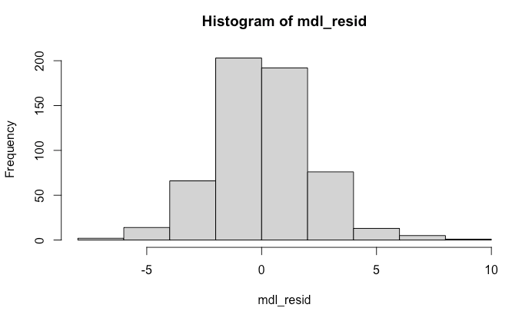
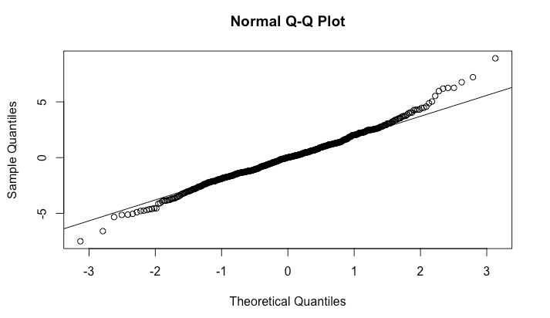
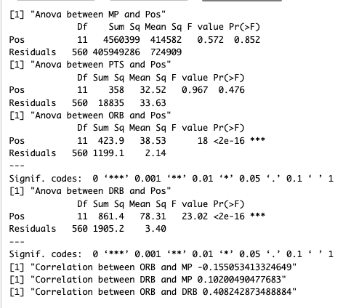
Model Diagnostics
After we built our model, we ran some Diagnostics tests to see if we meet the requirements for linear regression.
Linearity:
Unsatisfied, as seen on Q-Q plot, the tails to do not follow the line
Constant Variance:
Unsatisfied, as the tails of the Q-Q plot drift from the line
Normality:
Distribution seems to be about satisfied as seen on the histogram
Independence:
Not satisfied as seen between Pos → ORB and Pos → DRB

Slide 15

Prediction
For our prediction with our multi-linear model, we created five new players with sample values for our explanatory variables and 3-points attempted.
We used Sum of Squared Residuals (RSS) to check our accuracy:
We got a relatively low RSS, showing that our model is not terribly wrong at predicting 3-points attempted.
However, there is definitely room for improvement. We could try to add more variables, and compare our results from forward selection and backward elimination to likely get the best model possible.

Slide 16
Analysis 3: Logistic Regression
Logistical regression to determine highest fouled position.
Response: free-throw attempts (FTA)
Explanatory: position (POS), minutes played (MP).
Free-throw attempts are directly linked to the frequency a player is fouled.
Free-throw attempts include both: Technical and Personal fouls
Influence on technical fouls is minimal because they are generally far less frequent.
Free-throw attempts converted to Binary:
If >= 3, then 1. Else, 0.
Importance lies in helping provide insight to understand the impact of play time on foul frequency across all positions in Basketball, in addition to determining the highest fouling position.

Slide 17
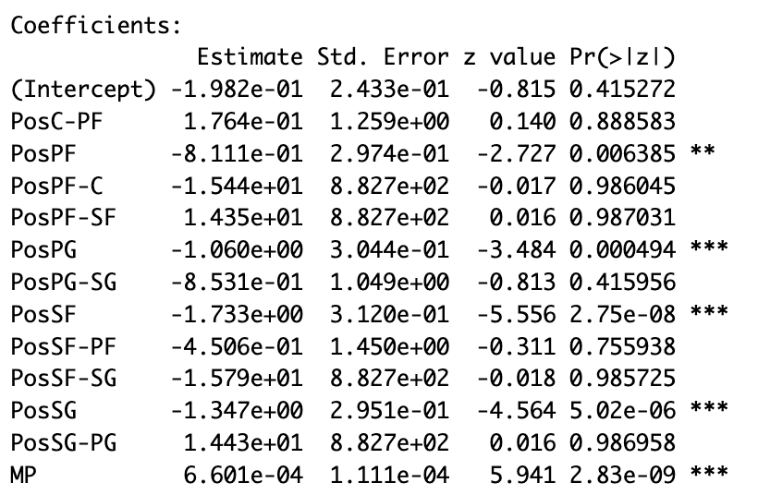
Analysis 3: Logistic Regression
H₀: A player’s position has no effect on the probability of a free-throw attempt, and the alternative hypothesis is
H₁: A player’s position has an effect on the probability of a free-throw attempt.
After creating the logistical model, we can find the significant variables relating to the baseline center position.
Reject the null hypothesis, as there is sufficient evidence to suggest a players position has a statistically significant influence on free throw-attempts. Additionally, minutes played is also significant.
Ignore data with multiple positions, because of lack of sample representation

Slide 18
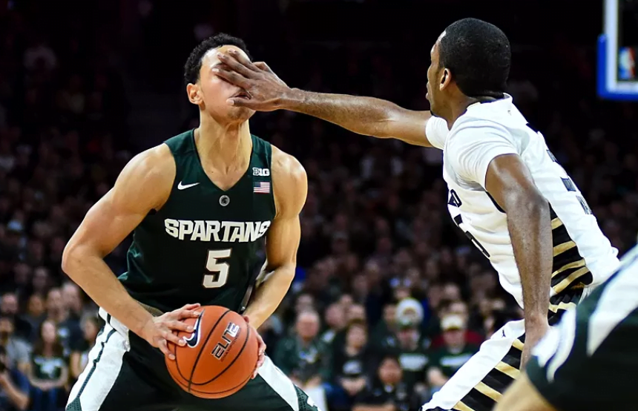
Analysis 3: Logistic Regression
Log-odds
Free-throw attempt change with a one-unit increase in minutes played
1.00066, or 0.66%
Positive, suggesting every minute played increases the odds of attempting a free-throw by 0.66%.
Can be applied to fouls:
The longer you are on the court, the higher the chance of getting fouled is.

Slide 19
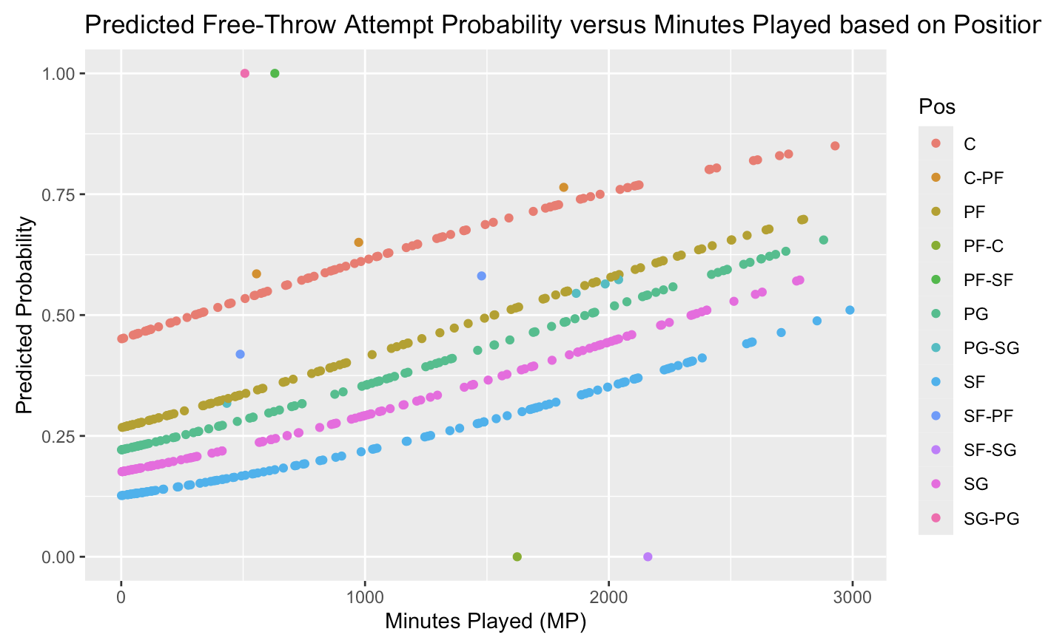
Analysis 3: Logistic Regression
Center has the highest predicted probability of attempting a free-throw amongst all positions.
Generally consistent with real-world data.
Notice, all positions are trending upwards, as the minutes played increases.
Center has the highest predicted probability of attempting a free-throw, thus also a high probability of getting fouled.
Centers are typically near the basket, and play a physically aggressive position.

Slide 20
Conclusion
Analysis 1
There is a significant difference between the field goal percentage of a Center compared to a Power forward, meaning the position of player does have some effect on their field goal percentage
Analysis 2
There are multiple factors, such a player’s position and a player’s minutes, which affect a player’s 3 point attempt
Analysis 3
There is a significant relationship between a player’s positions and a player’s free throw attempts

